Slide 1

Introduction to
Machine Learning
Y-DATA: Yandex School of Data Analysis — 2020
Dr. Hanan Shteingart

Slide 2


WIIFM?
“If you invent a breakthrough in AI, so machines can learn, that is worth 10 Microsofts”
— Bill Gates, Former Chairman, Microsoft. 2004

Slide 3
General Outline
What is ML?
What are the types of ML Problems?
How is ML in Practice?
Estimating Model Performance
Bias Variance Tradeoff
Curse of Dimensionality
Statistical Learning Theory - Most likely will not to here

Slide 4
What is ML?

Slide 5
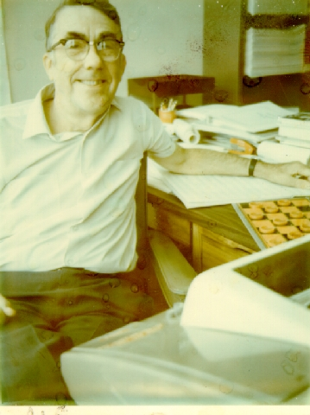
The Arthur Samuel’s Checkers
“Machine Learning: Field of study that gives computers the ability to learn without being explicitly programmed.”
— Arthur Samuel (1959)
The Samuel Checkers-playing Program was among the world's first successful self-learning programs, and as such a very early demonstration of the fundamental concept of artificial intelligence (AI).

Slide 6
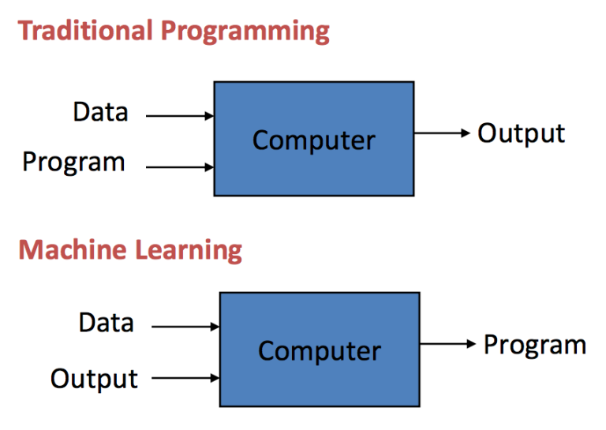
How is Machine Learning Relates to Programming
True Mainly for Supervised Learning, see Next

Slide 7
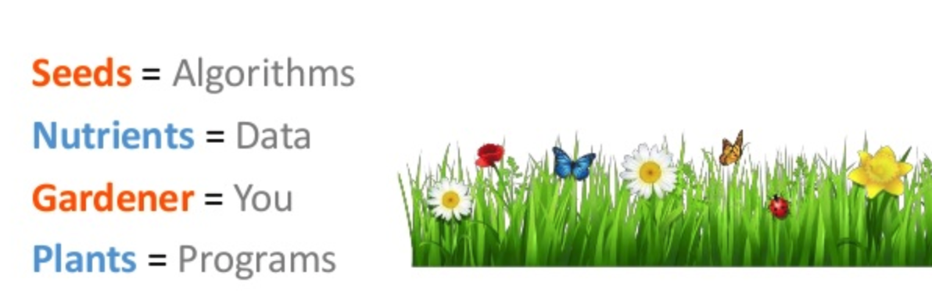
Agriculture Metaphor of ML
“Machine learning is like farming or gardening. Seeds is the algorithms, nutrients is the data, the gardner is you and plants is the programs.” A Study on Machine Learning: Overviews and Applications International conference on Recent Trends in Artificial Intelligence, IOT, Smart Cities & Applications (ICAISC-2020)

Slide 8
The PTE View on ML
Machine Learning is the study of algorithms that
improve their performance (P)
at some task (T)
with experience (E).
A well-defined learning task is given by <P, T, E>.
e.g., predict house pricing (T), according to last year’s data (E), minimizing the square error (P).
https://courses.cs.washington.edu/courses/cse473/04au/lectures/14-ml-intro.pdf
Performance
Experience
Task

Slide 9

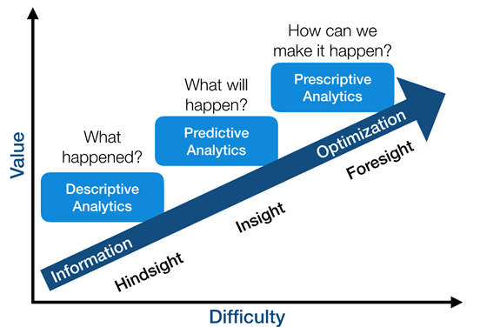


Descriptive vs. Predictive vs. Prescriptive
Supervised
Reinforcement Learning, Bandits, Causal Inference
Estimations, Hypothesis Testing, Unsupervised

Slide 10
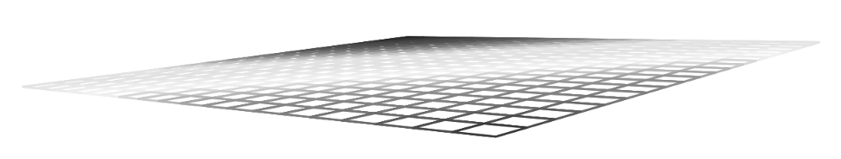
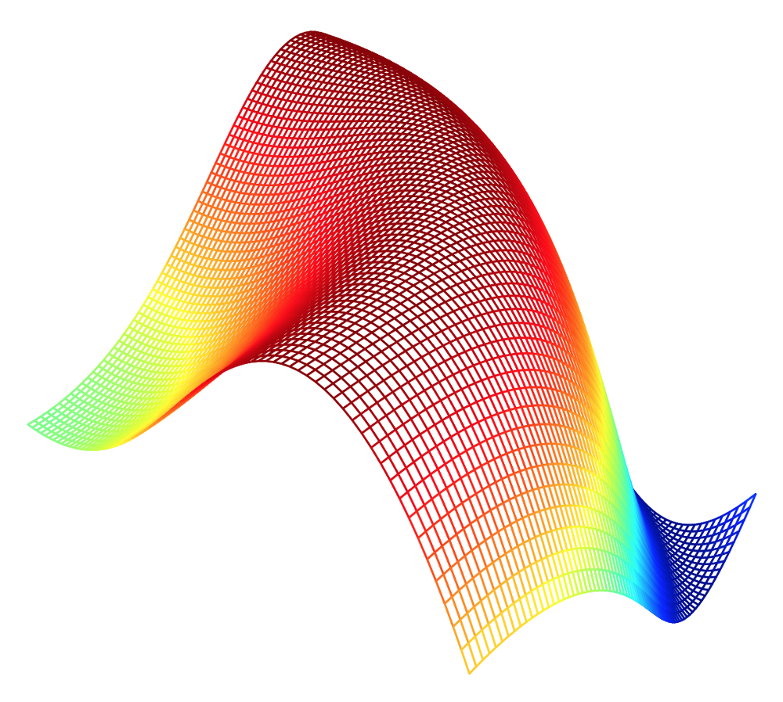
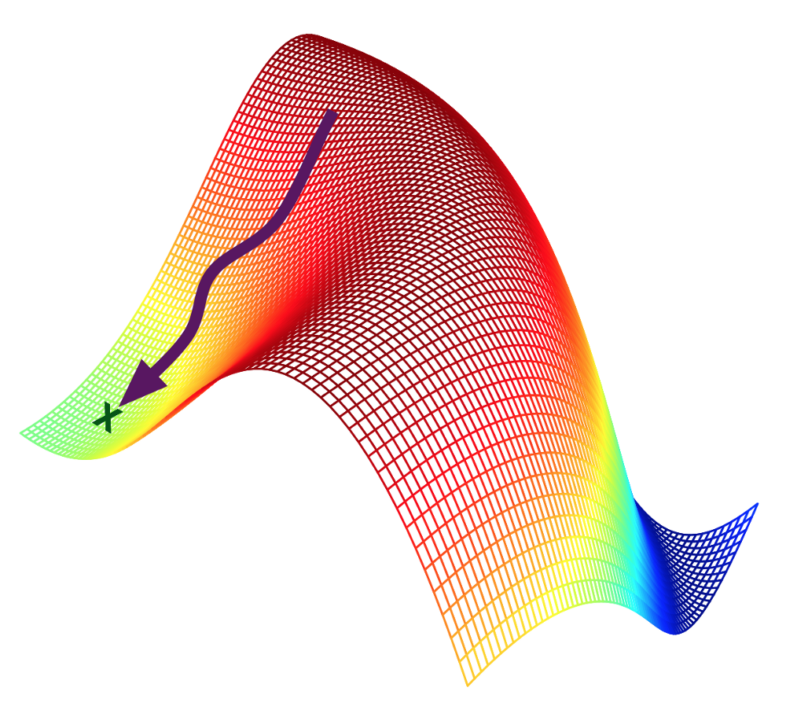
Key Elements of Machine Learning
Representation: how to represent knowledge. The Model.
Evaluation: the way to evaluate candidate representations (programs/hypotheses).
Optimization: how to find the optimal representation in the evaluation terms.
Domingos, Pedro. "A few useful things to know about machine learning." Communications of the ACM 55.10 (2012): 78-87.

Slide 11
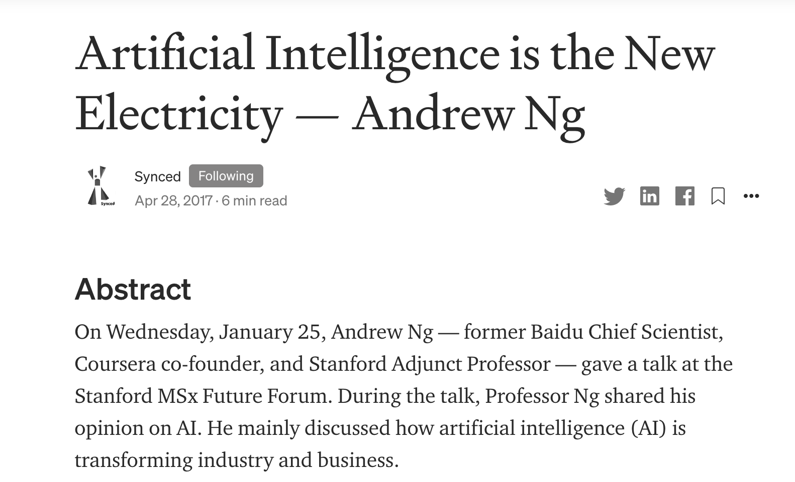
Application of Machine Learning
Sample applications of machine learning:
The
List
Is
Just
Too
Long
Machine Learning is the new Electricity
Notes:
Web search: ranking page based on what you are most likely to click on.
Computational biology: rational design drugs in the computer based on past experiments.
Finance: decide who to send what credit card offers to. Evaluation of risk on credit offers. How to decide where to invest money.
E-commerce: Predicting customer churn. Whether or not a transaction is fraudulent.
Space exploration: space probes and radio astronomy.
Robotics: how to handle uncertainty in new environments. Autonomous. Self-driving car.
Information extraction: Ask questions over databases across the web.
Social networks: Data on relationships and preferences. Machine learning to extract value from data.
Debugging: Use in computer science problems like debugging. Labor intensive process. Could suggest where the bug could be.

Slide 12
II. What are the types of ML Problems?

Slide 13
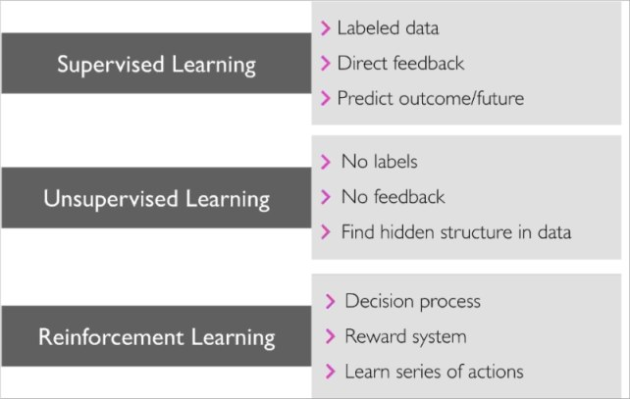
Types of ML
List of Machine Learning Algorithms 3 different types of machine learning

Slide 14
Additional Types of Learning
Semi-Supervised learning Training data includes a few desired outputs.
Causal Inference Learning
Discover and estimate the causal relationship between variables
Notes:
Reinforcement learning: you don’t know what is the target function (labels), but get feedback only in terms of reward/cost.

Slide 15
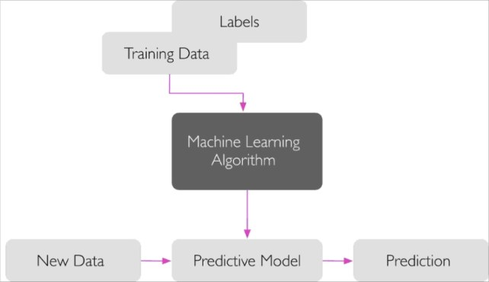
Supervised
https://www.quora.com/What-is-supervised-learning

Slide 16
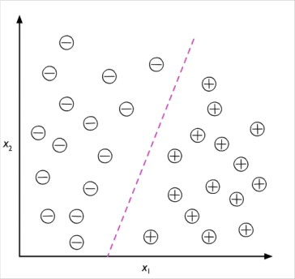
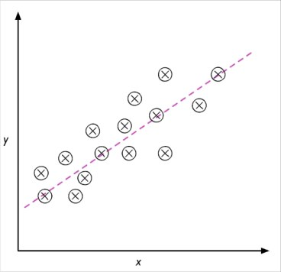
Regression Vs Classification
Classification Regression

Slide 17
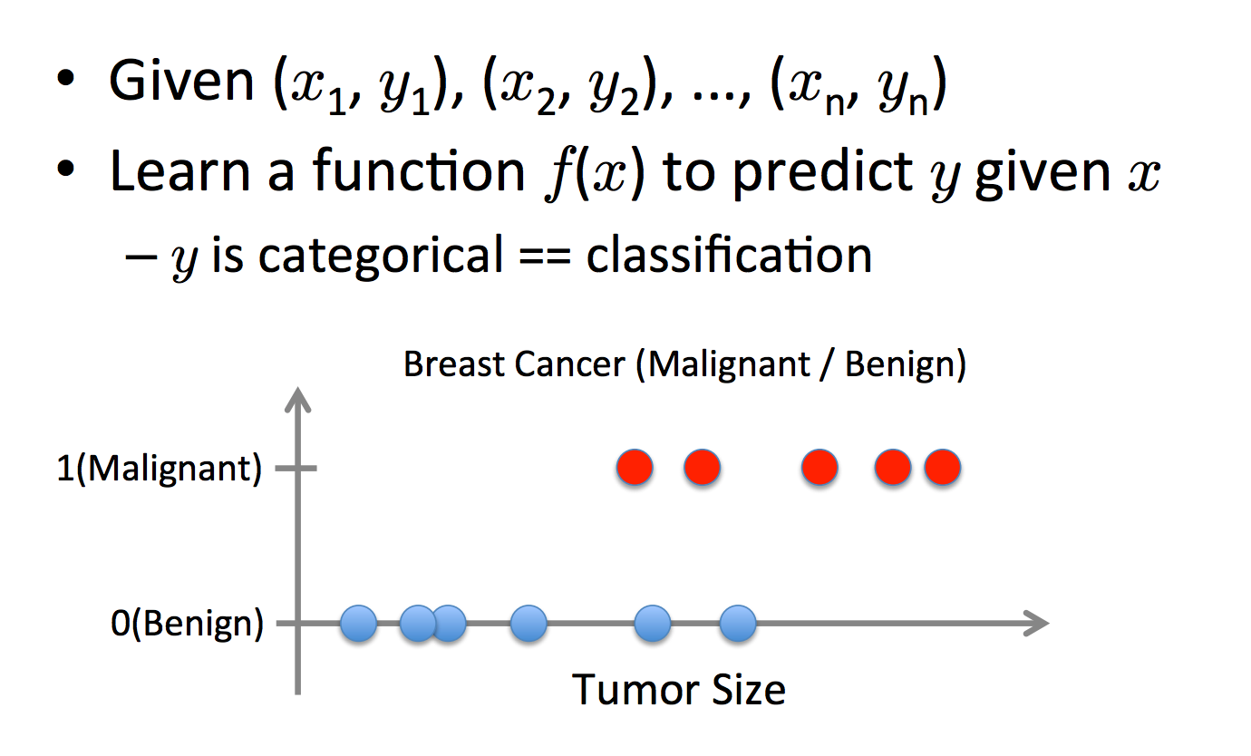
Supervised Classification

Slide 18
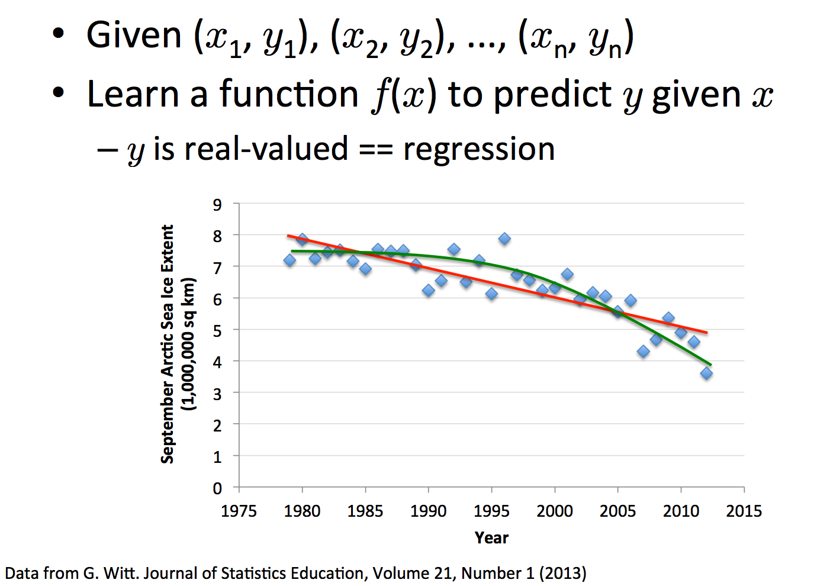
Supervised Regression

Slide 19
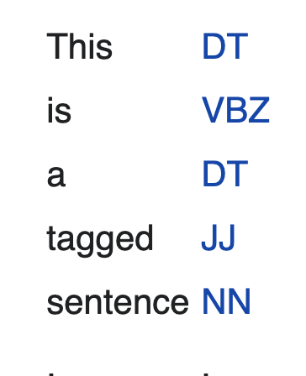
Type of Supervised Learning
Output Data Type
Discrete - Classification
Continuous - Regression
Structured - Structure Prediction (e.g. sentence tagging)
Classification Types:
Multi-class
Multi-label
Regression Types:
Dimensions - Uni/Multivariate
Monotonic - Isotonic Regression
Loss Function - MSE, MAE
Regularization Type - Lasso, Ridge, etc
Percentile - Quantile Regression

Slide 20
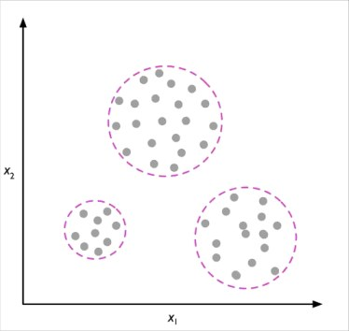
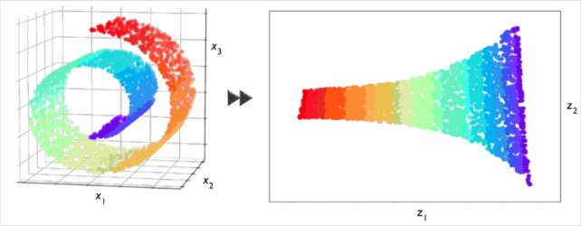
Unsupervised Learning
Clustering
Dimension Reduction

Slide 21
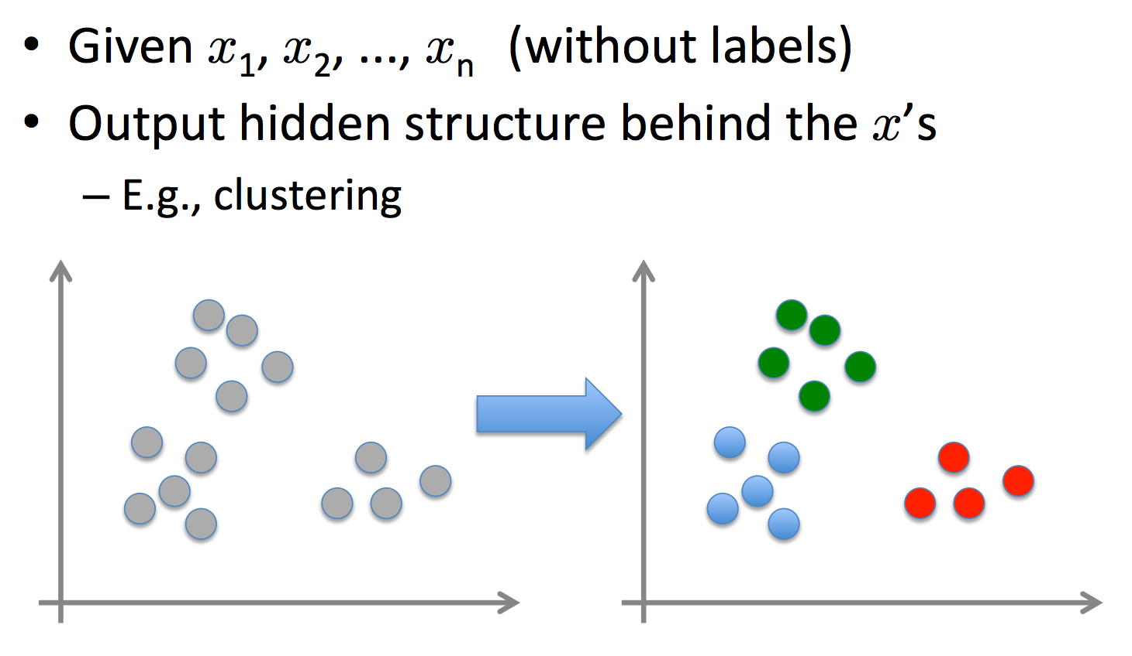
Unsupervised

Slide 22
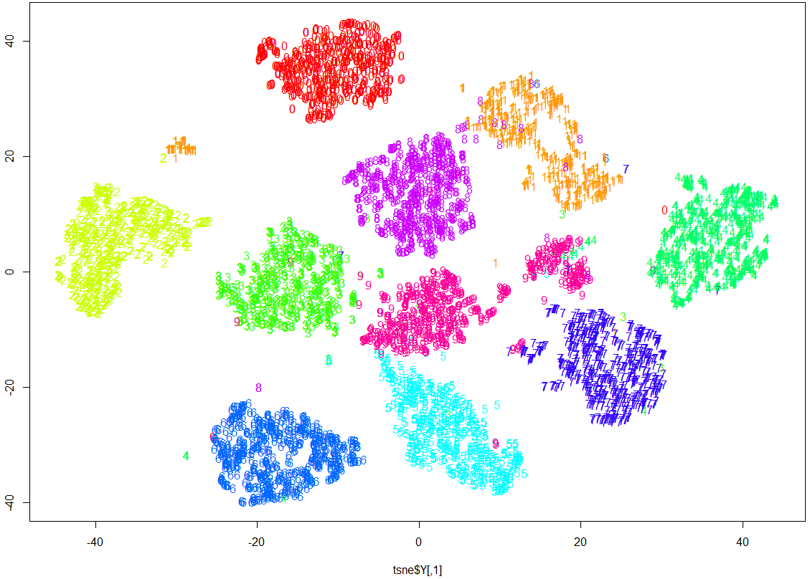

Unsupervised Example
https://mark-borg.github.io/blog/2016/tsne-ml/

Slide 23
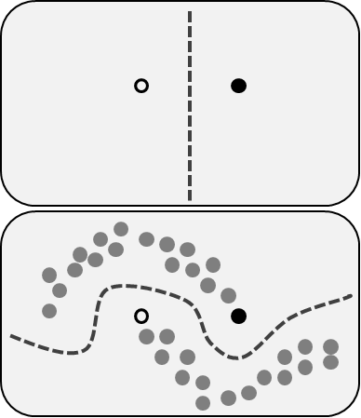
Semi-supervised Learning Example
Antivirus:
Some files are known to be safe
Some are known to be malicious
Most are unknown
https://en.wikipedia.org/wiki/Semi-supervised_learning

Slide 24
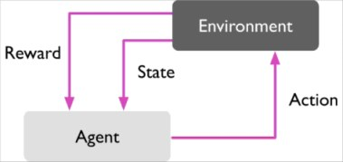
Reinforcement Learning

Slide 25
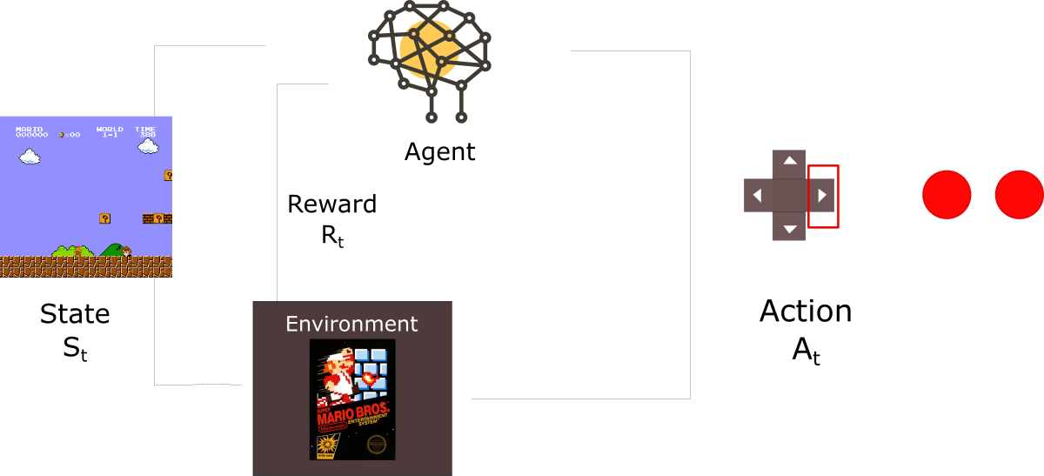
RL Example
https://medium.freecodecamp.org/an-introduction-to-reinforcement-learning-4339519de419

Slide 26
What types of ML Algorithms are there?

Slide 27
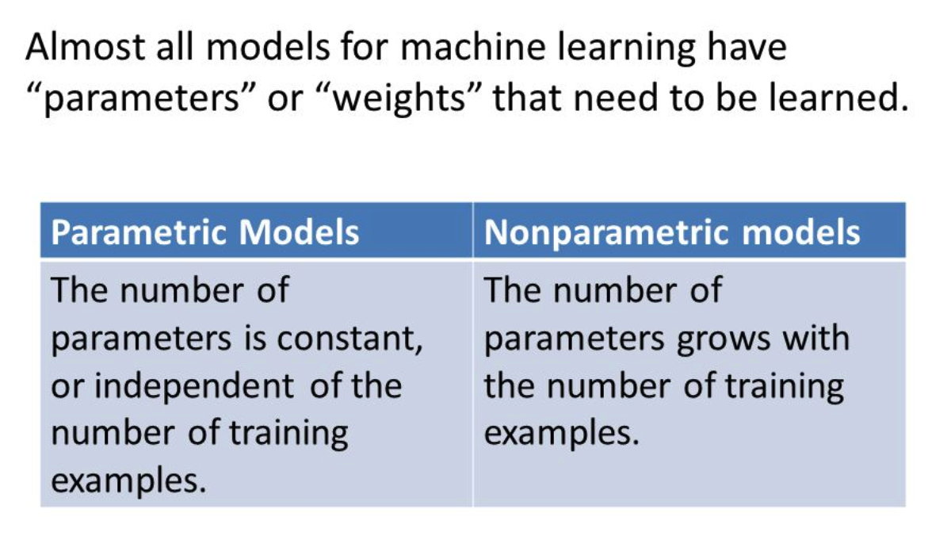
Parametric vs. Non-parametric Models

Slide 28

Can you think of an example?
Can you think of an example for parametric and non-parametric method?

Slide 29
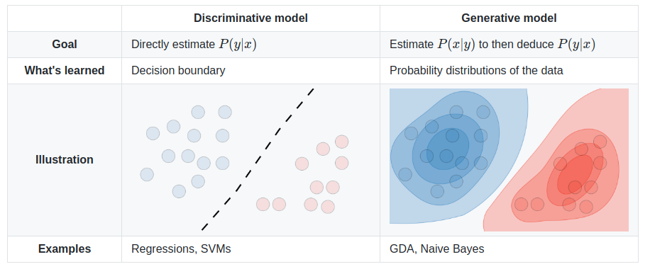
Generative vs. Discriminative
https://stackoverflow.com/questions/879432/what-is-the-difference-between-a-generative-and-discriminative-algorithm

Slide 30
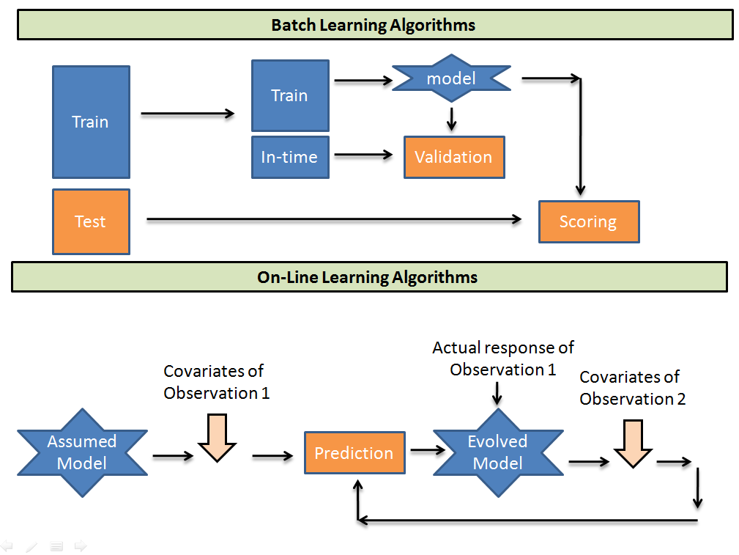
Batch vs. Online
https://www.analyticsvidhya.com/blog/2018/01/online-learning-guide-text-classification-vowpal-wabbit-vw/

Slide 31
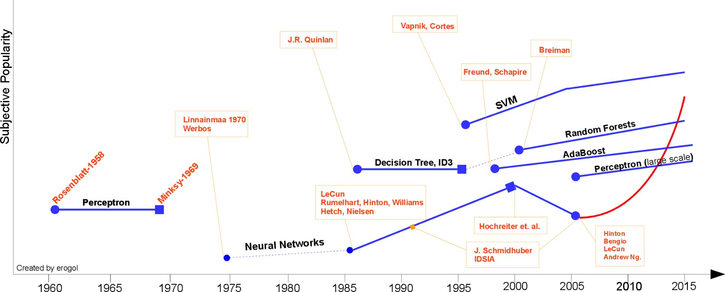
The Brief History of Machine Learning
https://chatbotnewsdaily.com/since-the-initial-standpoint-of-science-technology-and-ai-scientists-following-blaise-pascal-and-804ac13d8151
Notes:
Always start with a simple baseline model for comparison

Slide 32
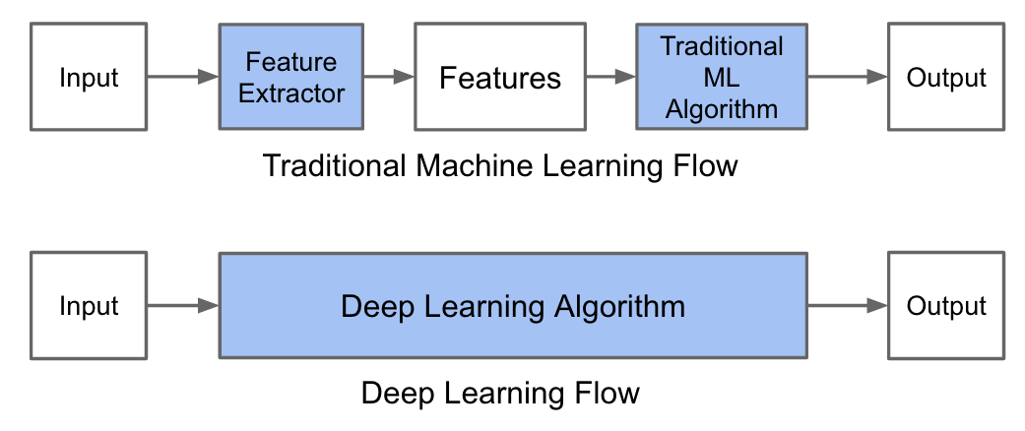
Classical vs Deep Learning Framework
http://adilmoujahid.com/posts/2016/06/introduction-deep-learning-python-caffe/

Slide 33

Some Realities on DL
Don’t be fool by the hype
Can be beaten by GBT for tabular data (CatBoost, XGBoost, LightGBM).
No Feature Engineering - Yuppie. Yet… Network Architecture Search (NAS), Annoying GPU issues, Loss design, hours of training
Overkill sometimes and infeasible
Example: try to train a DL to predict if a number is even or odd…

Slide 34
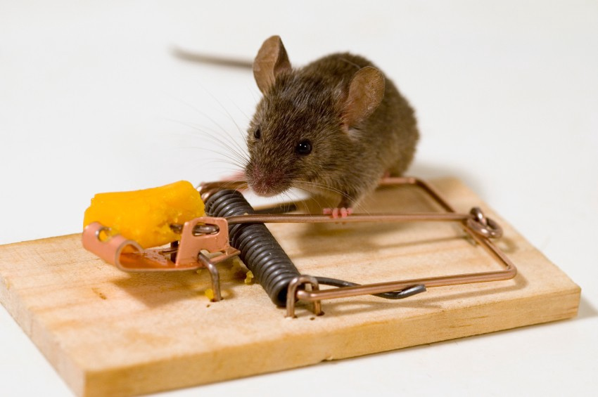
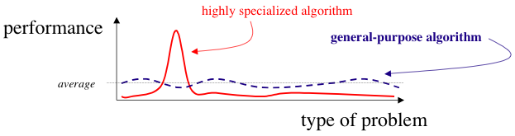
No Free Lunch Theorem - Best Model Does Not Exists
A superior black-box optimisation strategy, which is better than anything else for any kind of problem, is impossible.
Deep cannot be always better.
https://medium.com/@LeonFedden/the-no-free-lunch-theorem-62ae2c3ed10c
Notes:
No single model to rule them all

Slide 35
III. ML in Practice

Slide 36
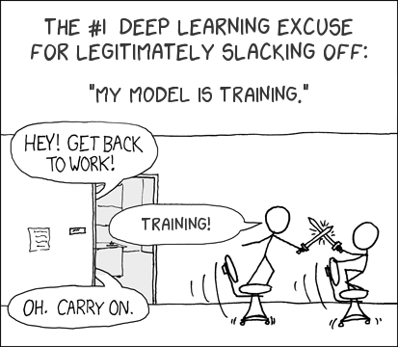

Slide 37
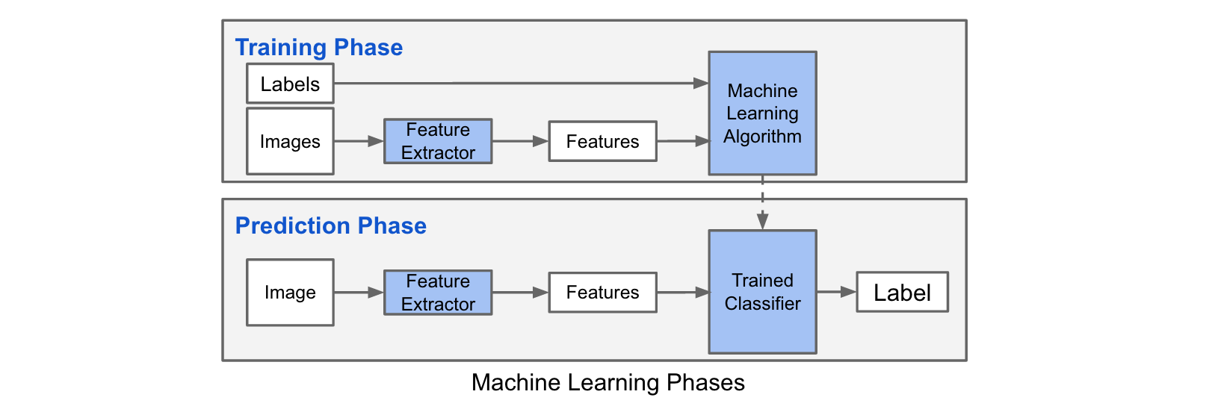
Train vs Test Pipelines

Slide 38
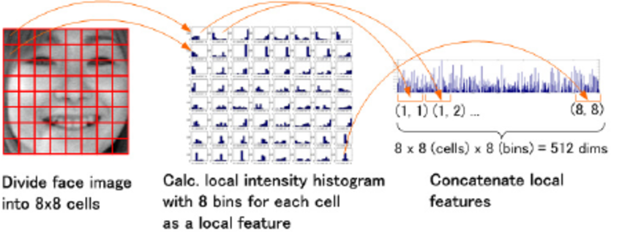
Feature Extraction
“Algorithm which transforms raw data into numeric values which can be used as input to a learning algorithm. Usually helps with reducing and fixing dimensionality.”
e.g.
Shimada K., Matsukawa T., Noguchi Y., Kurita T. (2011) Appearance-Based Smile Intensity Estimation by Cascaded Support Vector Machines. In: Koch R., Huang F. (eds) Computer Vision – ACCV 2010 Workshops. ACCV 2010. Lecture Notes in Computer Science, vol 6468. Springer, Berlin, Heidelberg
Notes:
In addition, sometimes the transformation process is crucial for the success of the learning process - for example, a non-linear transformation can help a linear classifier perform better.

Slide 39
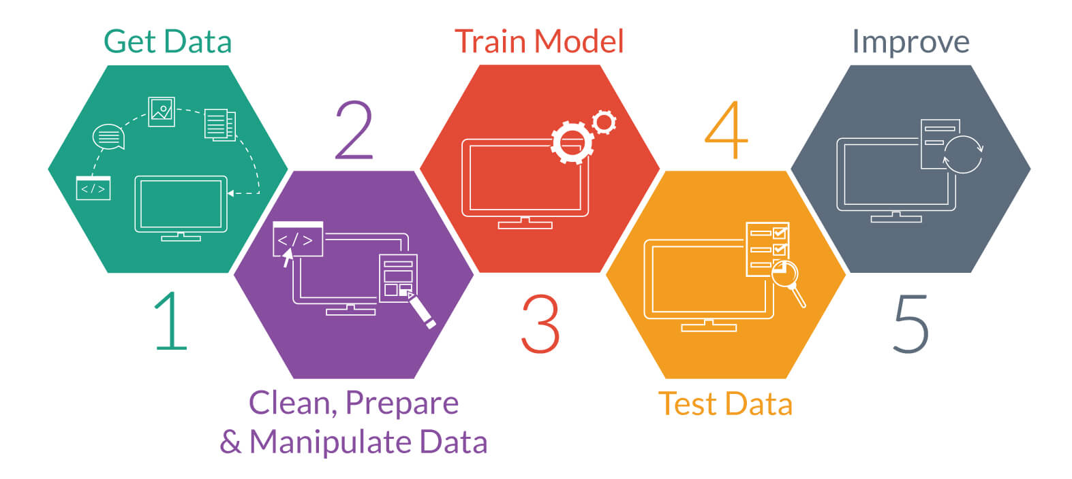
Steps to Predictive Modeling

Slide 40

Understand the domain and explore the data
Data integration, selection, cleaning and pre-processing.
Learning models ← ML part
Interpreting results.
Consolidating and deploying discovered knowledge.
It is not a one-shot process, it is a cycle. You need to run the loop until you get a result that you can use in practice. Also, the data can change, requiring a new loop.
Notes:
Understand the domain, prior knowledge and goals. Talk to domain experts. Often the goals are very unclear. You often have more things to try then you can possibly implement.
Data integration, selection, cleaning and pre-processing. This is often the most time consuming part. It is important to have high quality data. The more data you have, the more it sucks because the data is dirty. Garbage in, garbage out.
Learning models. The fun part. This part is very mature. The tools are general.
Interpreting results. Sometimes it does not matter how the model works as long it delivers results. Other domains require that the model is understandable. You will be challenged by human experts.
Consolidating and deploying discovered knowledge. The majority of projects that are successful in the lab are not used in practice. It is very hard to get something used.
It is not a one-shot process, it is a cycle. You need to run the loop until you get a result that you can use in practice. Also, the data can change, requiring a new loop.

Slide 41
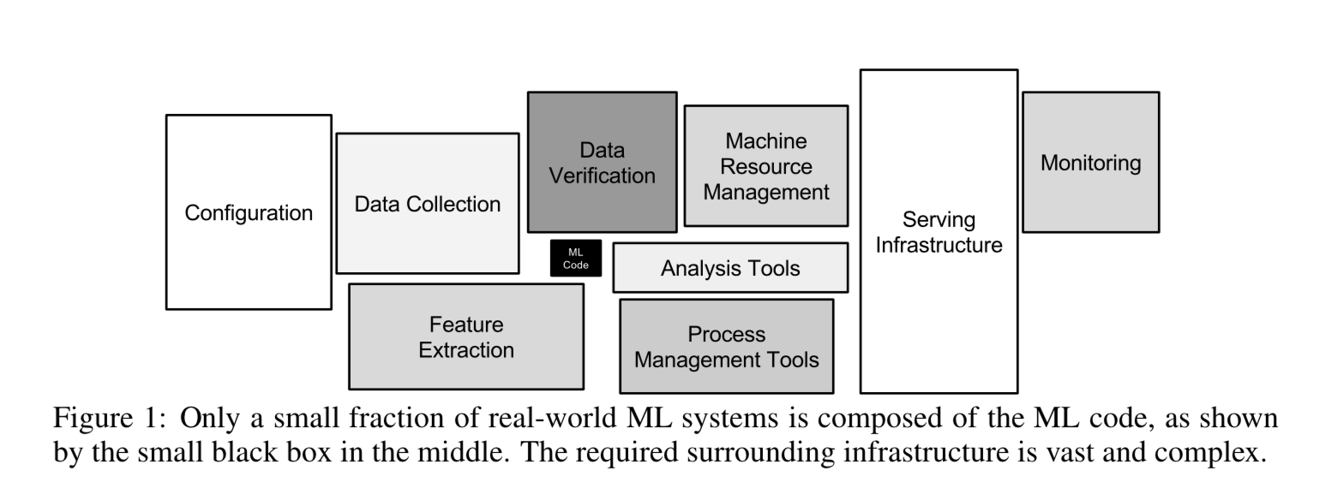
Hidden Technical Debt in Machine Learning Systems
You are here
https://papers.nips.cc/paper/5656-hidden-technical-debt-in-machine-learning-systems.pdf

Slide 42
V. Project/Product Management

Slide 43

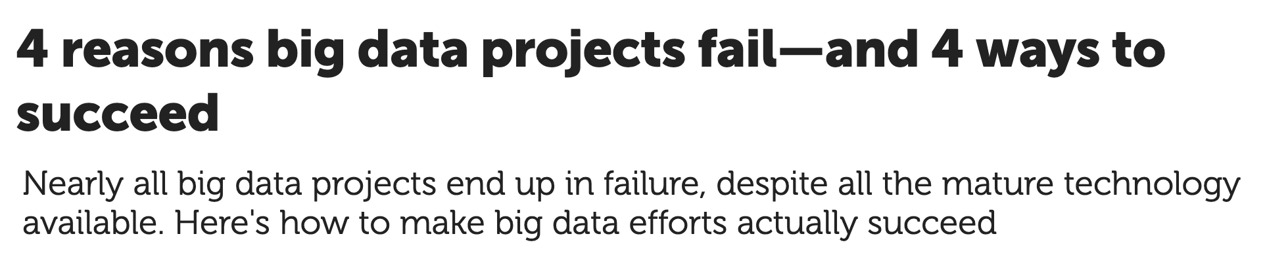
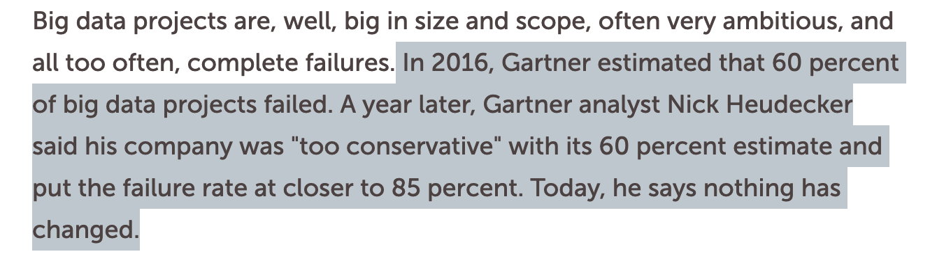
Why 85% of DS projects fail?
link

Slide 44

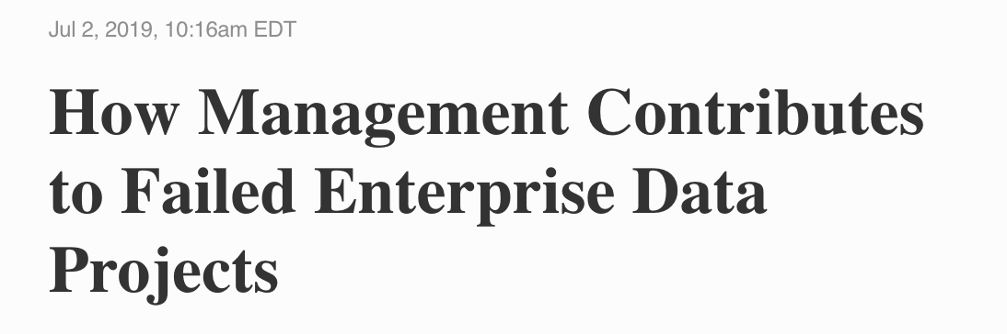
This is Why :-)
link

Slide 45

Translators
https://www.mckinsey.com/business-functions/mckinsey-analytics/our-insights/analytics-translator#
Why are translators so important? They help ensure that organizations achieve real impact from their analytics initiatives (which has the added benefit of keeping data scientists fulfilled and more likely to stay on, easing executives’ stress over sourcing that talent).

Slide 46

Data Science Project Management
Very good (and maybe only) - https://www.datascience-pm.com/

Slide 47

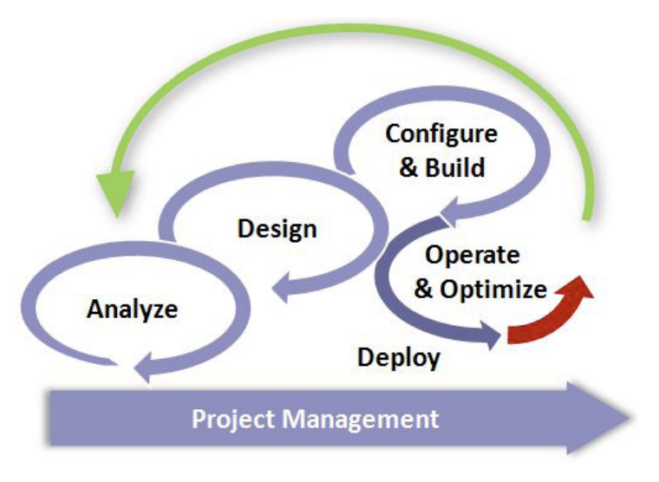
CRISP-DM - Cross-industry standard process for data mining
A process by IBM
Analytics Solutions Unified Method (ASUM)

Slide 48

The Team Data Science Process (TDSP)
A process by Microsoft
https://docs.microsoft.com/bs-cyrl-ba/azure/machine-learning/team-data-science-process/overview

Slide 49
IV. Estimating Model Performance

Slide 50
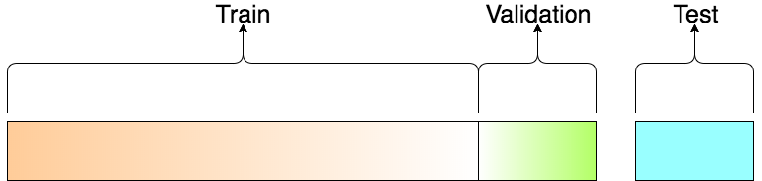
Estimating Performance
E.g. Choose best model
Hyper parameter optimization

Slide 51
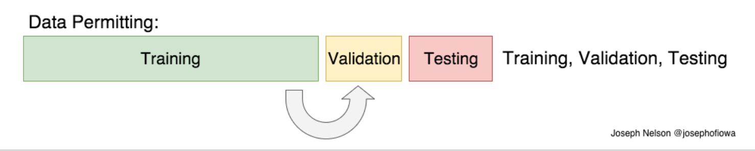
Estimating Performance - Data is Abundant

Slide 52
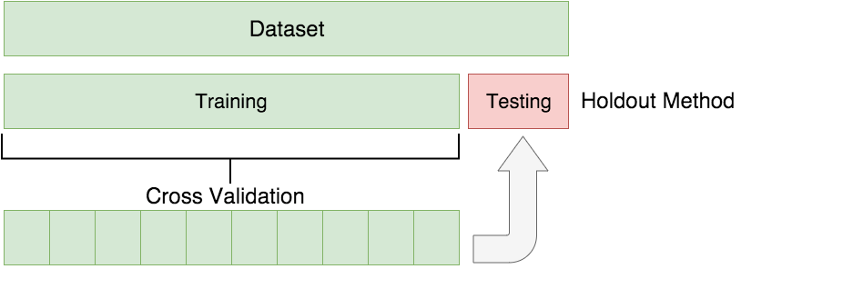
Cross Validation
Notes:
2 level cross validation will also estimate the generalization error by splitting the data also for creating the “test” sets (then, on each split applying cross-validation on some of the data, and applying error estimate on the test part, eventually averaging the results on the “test” sets to have lower bias estimate of the generalization error)
“Leave one out” is an extreme case of cross validation, where each iteration we leave only one example for validation and train on all others - but besides computational cost, it can also have other disadvantages (see: https://stats.stackexchange.com/questions/154830/10-fold-cross-validation-vs-leave-one-out-cross-validation)

Slide 53
V. Bias Variance Tradeoff

Slide 54
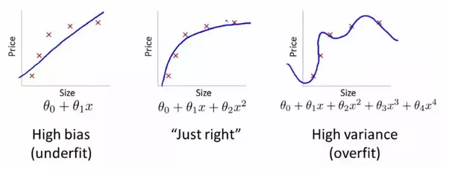
Bias Variance Tradeoff - Regression
https://www.quora.com/What-is-the-best-way-to-explain-the-bias-variance-trade-off-in-layman%E2%80%99s-terms

Slide 55
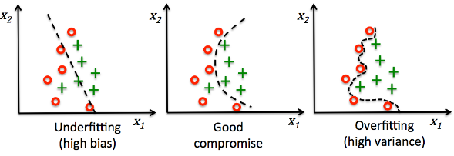
Bias Variance Tradeoff - Classification

Slide 56
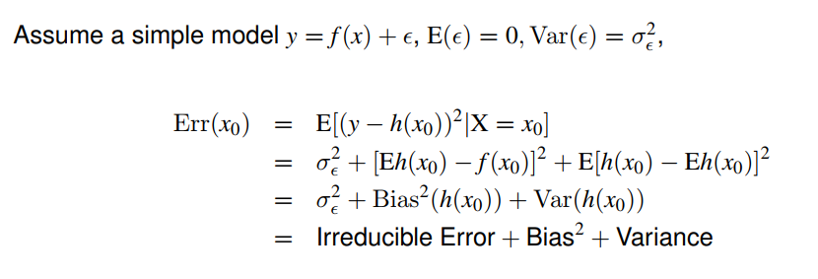
Total Error
Optional pencil and paper exercise: prove it in details
Notes:
See also:
https://en.wikipedia.org/wiki/James%E2%80%93Stein_estimator
https://apps.dtic.mil/dtic/tr/fulltext/u2/1028390.pdf
http://www-stat.wharton.upenn.edu/~lbrown/Papers/2012b%20A%20Geometrical%20Explanation%20of%20Stein%20Shrinkage.pdf

Slide 57

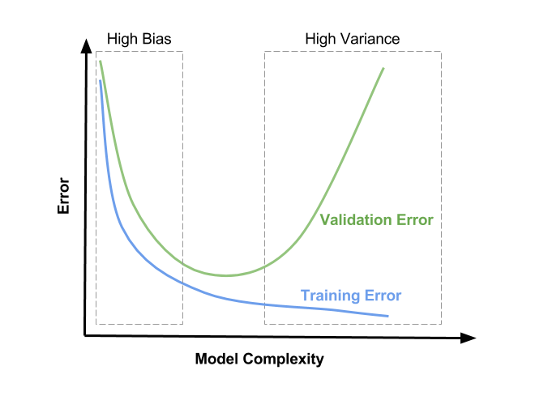
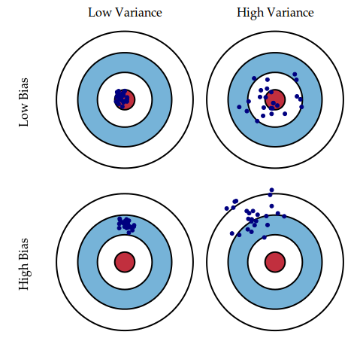
Bias Variance Tradeoff

Slide 58
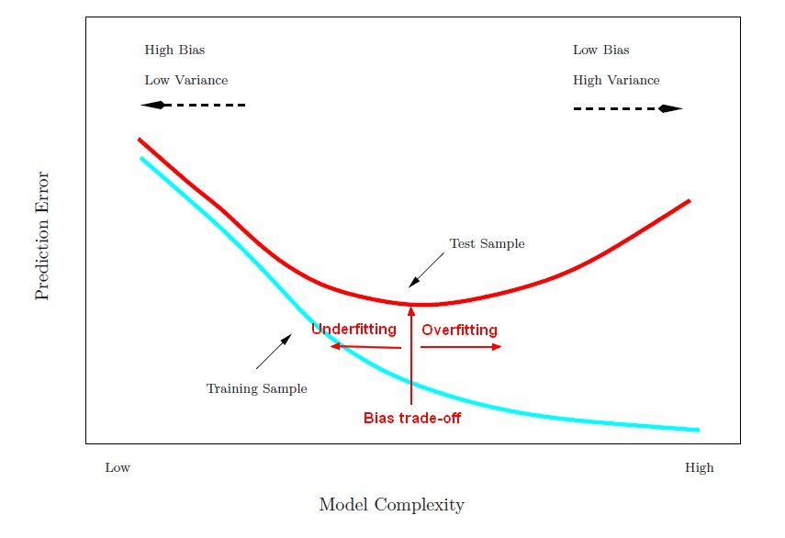
Over and Underfitting
https://gerardnico.com/wiki/data_mining/bias_trade-off

Slide 59
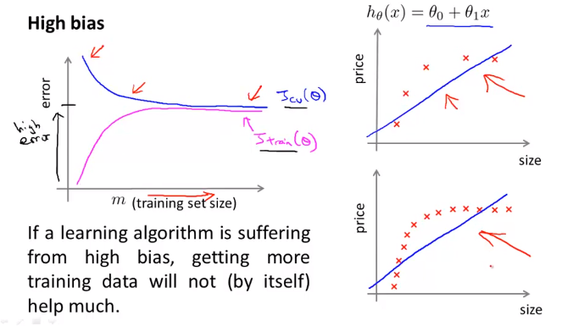
Bias Variance Analysis - Learning Curve
https://medium.com/@aiii/machine-learning-diagnostics-b2256d78d51e
Notes:
https://scikit-learn.org/stable/modules/learning_curve.html
https://scikit-learn.org/stable/auto_examples/model_selection/plot_learning_curve.html

Slide 60
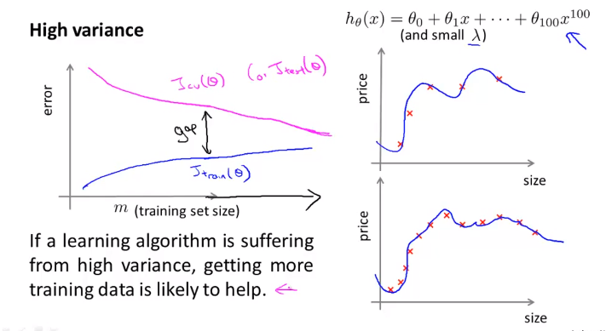
Bias Variance Analysis - Learning Curve
https://medium.com/@aiii/machine-learning-diagnostics-b2256d78d51e
Notes:
https://scikit-learn.org/stable/modules/learning_curve.html
https://scikit-learn.org/stable/auto_examples/model_selection/plot_learning_curve.html

Slide 61
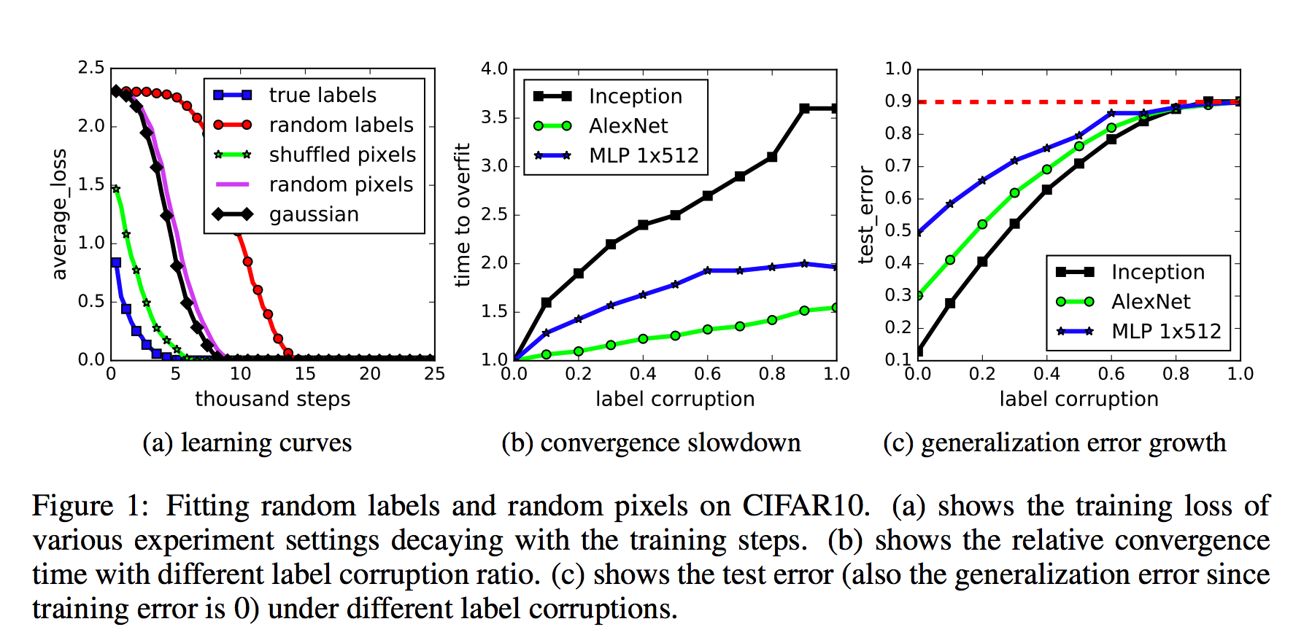
Understanding deep learning requires rethinking generalization
https://arxiv.org/abs/1611.03530
Notes:
Even simple DL “memorizes” the training set - so the generalization is not due to model structure or other kinds of regularization but probably more related to the nature of distribution of the data.

Slide 62
VI. The Curse of Dimensionality

Slide 63

Hughes phenomenon (1968) (Peaking Paradox)
http://37steps.com/2322/hughes-phenomenon/
Notes:
This is yet another way to think about the bias-variance tradeoff

Slide 64

Why Nearest Neighbours Fails in High Dimensions?
Kevin Murphy's book: Machine Learning - A probabilistic Perspective

Slide 65


Cube vs. Sphere

Slide 66

High Dimensional Data is Spiky

Slide 67

Beyer et. al. Theorem
The difference between the maximum and minimum distances to a given query point does not increase as fast as the nearest distance to any point in high dimensional space.
This makes a proximity query meaningless and unstable because there is poor discrimination between the nearest and furthest neighbor.
Notes:
Think about images: those have extremely high dimension, and nearest neighbour in some perspective will not work well (the distance between two cats or a cat and a dog basically means nothing in this high dimension)

Slide 68

Curse of Dimensionality
See home exercise

Slide 69

Curse in Action (Linear vs. KNN)
Setup: one dimension is non linear, the others are linear.
In low dim, KNN beats linear
As p increases KNN becomes useless

Slide 70
VII. Primer on Statistical Learning Theory

Slide 71

PAC

Slide 72
Terminology - data and hypotheses
Domain X: descriptions (input)
Domain Y: predictions (labels/outcome)
H: hypothesis space; the set of all possible hypotheses
h: a target hypothesis
f: best possible hypothesis, not necessarily in H (the true unknown model)
Notes:
In the energy-based model framework (a way of looking at nearly all machine learning architectures), inference chooses a configuration to minimize an energy function while holding the parameters fixed; learning chooses the parameters to minimize the loss function.

Slide 73

Terminology - risk (error rate)
h := f
H := F
l := some loss function
UNKNOWN!
OBSERVED

Slide 74




Terminology - risk (error rate) examples
True risk (generalization error): what is the risk of using an hypothesis
Classification
Regression
Empirical risk (training error): what is the performance on the sample set
Classification
Regression

Slide 75



Behavior of True Risk
H
Estimation error (variance)
Excess (true) risk
Approximation error (bias)

Slide 76
Finding the best hypothesis in H
Goal: minimizing the generalization error
Intuition:
Larger hypothesis space → better we can fit (reducing the approximation error, reducing bias)
Larger sample set → better we can generalize (reducing the estimation error, reducing variance)
The bigger the hypothesis space is → we would need a bigger sample set to work with

Slide 77
Simple Model - Realizable case, Finite H
Assume the sample data is independently identically distributed (i.i.d.) - each x is sampled independently according to some distribution
Assume realizability - given x, the label y is equal to some function f(x), and, f is in our hypothesis class
Assume H is finite in size (e.g., all functions from x to y that can be implemented using a Python program of length at most b)

Slide 78
Simple Model - Realizable case, Finite H
Claim: even in this case we can never hope to find h with zero risk, since there is always a chance (no matter how small) that we won’t see a certain unique sample in our sample set, and we won’t know how to label it
We would be happy if we can somehow ensure that with high probability the hypothesis we found has low error

Slide 79


Empirical Risk Minimization (ERM)
Given hypothesis class H and a sample set
Output any
What would the empirical risk be?

Slide 80
Empirical Risk Minimization (ERM)
Given hypothesis class H and a sample set
Output any
What would the empirical risk be?
… the empirical risk in this case would always be zero
Notes:
This is possible because we are in the realizable case

Slide 81


Probably Approximately Correct (PAC)
Theorem: Fix δ, ε. In the finite H realizable case, for any distribution D and true hypothesis f, the ERM (empirical risk minimization) learner is Probably (with probability of at least 1-δ, over the choice of sample set S) Approximately (up to accuracy ε) Correct, given a sample set of size m, where
And in math form, PAC means
if the sample size m holds the above condition.

Slide 82

PAC - proof (sketch)
H
Bad
h*=f

Slide 83





PAC - proof
Let’s say a classifier is bad if the true error rate is greater than ε
Then the probability that a bad classifier is consistent with m random, independent training examples is less than
Let b be the number of bad classifiers in H, the probability that at least one of them is consistent is less than , by the union bound
So, using also that , the probability that a learner which always returns a consistent classifier will return a bad one is less than
Finally, if we want that probability to be less than δ, we need to set
Notes:
Union bound: probability of union of events is less or equal to the sum of the events probabilities

Slide 84


Real world: Non-realizable case, Non-finite H
There are theoretical results for bounding the generalization error with respect to the sample set size even in those cases
Assume H is described by b bits and bound |H| with 2^{b} (discretization trick)
Use the description length of an hypothesis |h|, and assign a weight w(h)=2^{-|h|} for each hypothesis, then
Use the VC dimension of the hypothesis class, and if it is finite we get
Notes:
The discretization trick is not very elegant, and not accurate (we are only happy with a description using only b bits), but it is a great tool to estimate the upper bound
The description length could be for example the size of the executable implementing the model

Slide 85
Vapnik-Chervonenkis (VC) Dimension
A measure of the “power” or “complexity” of an hypothesis space - the higher the VC dimension is, the more “expressive” the hypothesis space is
How is it defined?
A set of N points is shattered by H if for any possible classification of those points, there exists an hypothesis h in H that is consistent with it
VC-dim(H) is the maximal number N of points that can be shattered by H

Slide 86
Vapnik-Chervonenkis (VC) Dimension
VC-dim(H) = d, if:
There exist a set of d points that can be shattered (need just one example of such a set)
There is no set of d+1 points that can be shattered (need to show for all possible sets)

Slide 87
VC-dim example: intervals in 1D
Assume a class of all positive intervals in 1D
What is the VC dimension of H?
a
b
Notes:
2

Slide 88
VC-dim example: intervals in 1D
Show that {0,1} can be shattered:
Possible classification assignments: {+,+}, {-,-}, {+,-}, {-,+}
Indeed all possibilities are covered:
0
1
0
1
0
1
0
1

Slide 89
VC-dim example: intervals in 1D
Show that no three point can be shattered:
If two (or more) of the 3 points are the same points, obviously we cannot classify them in any way that the same points won’t have the same classification - so it cannot be shattered
If all points are different, assume {a,b,c} where a<b<c, then there is no h in H that will assign the classification {+,-,+}, and again, it cannot be shattered

Slide 90
VC-dim examples
So the VC dimension of 1D positive intervals is 2
What is the VC dimension of 1D positive or negative intervals?
What is the VC dimension of 2D positive rectangles? Circles? Triangles?
Take it as a home exercise…

Slide 91
VC-dim ≠ number of parameters
Many times there is a good correlation between the number of free parameters in the model (number of parameters to learn in order to find the best h in H), and the complexity of the hypothesis space
However, this is not necessarily the case - consider the following hypothesis space

Slide 92

VC-dim ≠ number of parameters
One can prove the VC-dim of this class is infinite (although it has only 1 parameter)
The real problem is that we can pretty much fit any given sample set perfectly, but we will change our model considerably with every small change in the sample set, which will eventually lead to high generalization error, even if the training data could be classified with very low error rate
Notes:
See proof: http://mlweb.loria.fr/book/en/VCdiminfinite.html

Slide 93
Reading Materials
A few useful things to know about machine learning.pdf
CIS 419:519 Introduction to Machine Learning.pdf
Empirical Risk Minimization.pdf
Introduction to Statistical Learning Theory.pdf
On the Surprising Behavior of Distance Metrics in High Dimensional Space.pdf
Statistical learning theory - a primer.pdf
Statistical Machine Learning- Introduction.pdf
2012b A Geometrical Explanation of Stein Shrinkage.pdf
INADMISSIBILITY OF THE USUAL ESTIMATOR FOR THE MEAN OF MULTIVARIATE NORMAL DISTRIBUTION - STEIN.pdf
THE USE OF MULTIPLE MEASUREMENTS IN TAXONOMIC PROBLEMS - FISHER - 1936 - Annals of Eugenics - Wiley Online Library.pdf
Notes:
1,7,4,6

